Slide 1
CIOBrain
Project
Deployment
Anton Horvath / Anuja Sahu / Kevin Lieng / Jose Colina Salas / Saige Wright / Scott Lorance
Sponsor: Tom Hill — Fellows Consulting Group, LLC

Slide 2
Agenda
01
02
03
Overview
Objectives
MSI Installer
04
05
06
API Authentication
Data transfer
Azure script
What is CIOBrain?
What were we trying to accomplish?
MSI installer implementation
Authentication implementation
Transfer from native to Azure implementation
Easier Azure deployment implementation

Slide 3
CioBrain
01
OVERVIEW
What does it do?

Slide 4
Projects
Asset Management
Data
People
Chief information officers need to be aware of all assets owned by the company, along with relationships between them including:
Data
Applications
Projects
People
Infrastructure
Business
+ More

Slide 5
How it works
Import Excel
Create Excel
Display Assets
Import populated Excel spreadsheets into CIOBrain application
Create Excel spreadsheets with assets populated inside of them
All assets imported from the Excel spreadsheets can be displayed in the app

Slide 6
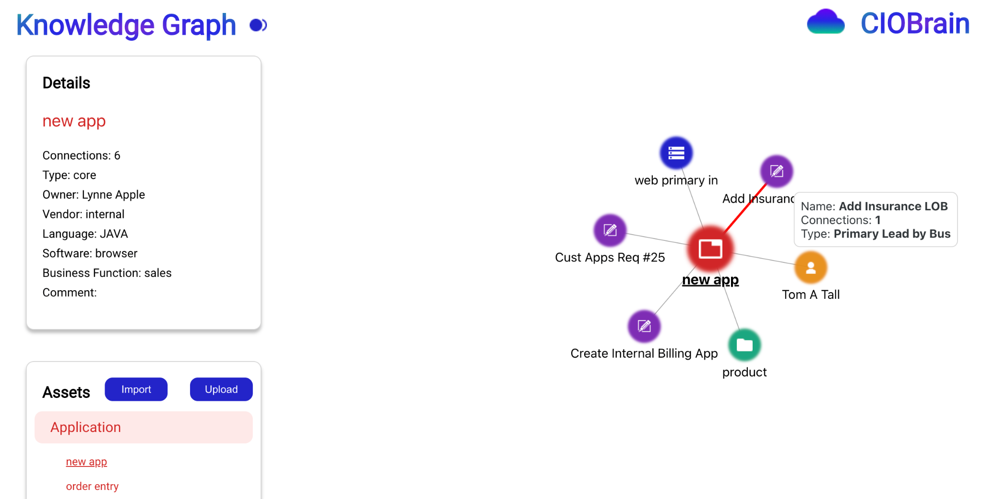

Slide 7
02
Objectives
This Semester
Tasks to accomplish

Slide 8




Objectives
MSI Installer
API Authentication
Data Transfer
Azure Script
Creating the native application
Securing the application’s API
Moving from native to cloud
Making cloud deployment easier

Slide 9
MSI
03
Installer
Creating the native application

Slide 10


MSI Creation
React Frontend
Node Backend
Excel Data
Native application
Web application displaying user interface
Web API handling backend services
GET …………
Runs offline, installed as a program in one click using MSI file

Slide 11
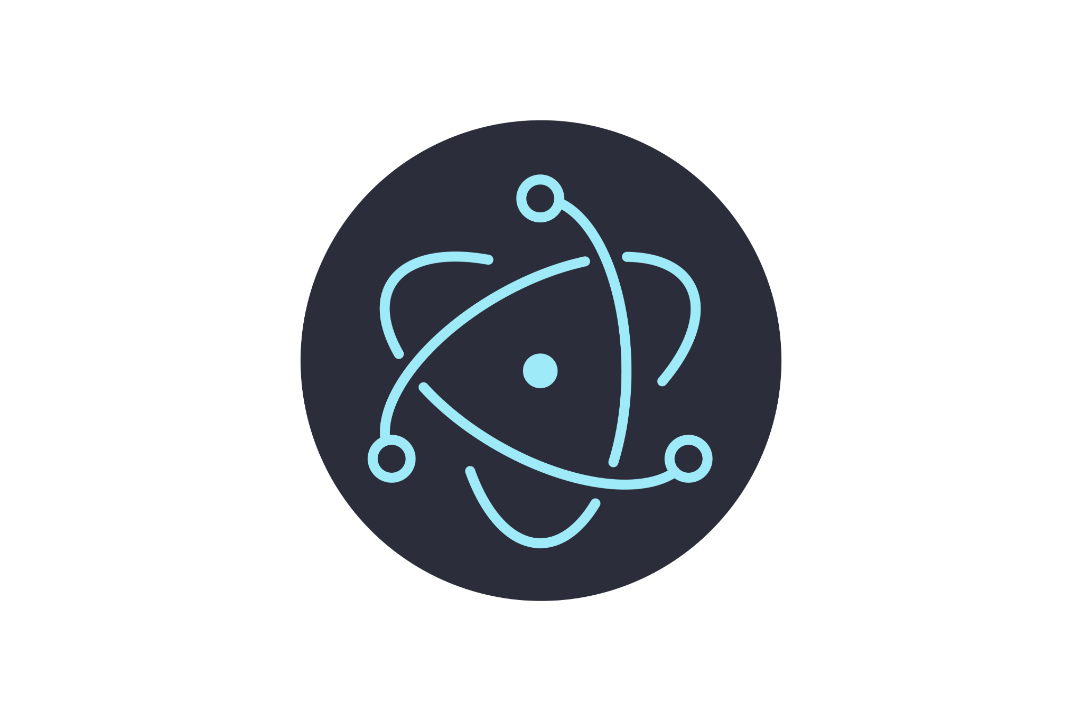
Electron.js
Build cross-platform desktop apps with JavaScript, HTML, and CSS

Slide 12
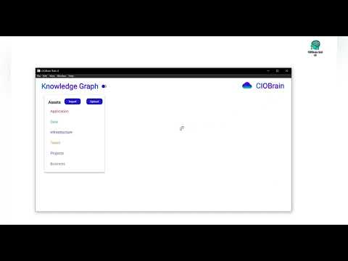
MSI Demo

Slide 13
04
API
Auth
Securing the application

Slide 14
React API
at its Core

Slide 15

API Authentication
Enters Password
CIOBrain Frontend
Post a package of login request to API
Sends response with authorization access information to elements of CIOBrain
Password is secure on desktop and on a hidden system file on the application so there is little chance of breach!
CIOBrain API
API checks for valid authentication
CIOBrain Authentication

Slide 16
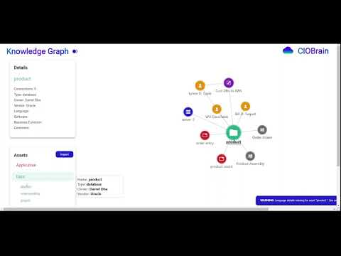
Login FUNCTIONALITY DEMO

Slide 17
Data
05
Transfer
Moving from native to cloud

Slide 18
Local APi
Upload
Azure API
User clicks “Upload” button on local machine
Enter API URL and password
Files imported to Azure, duplicates removed

Slide 19
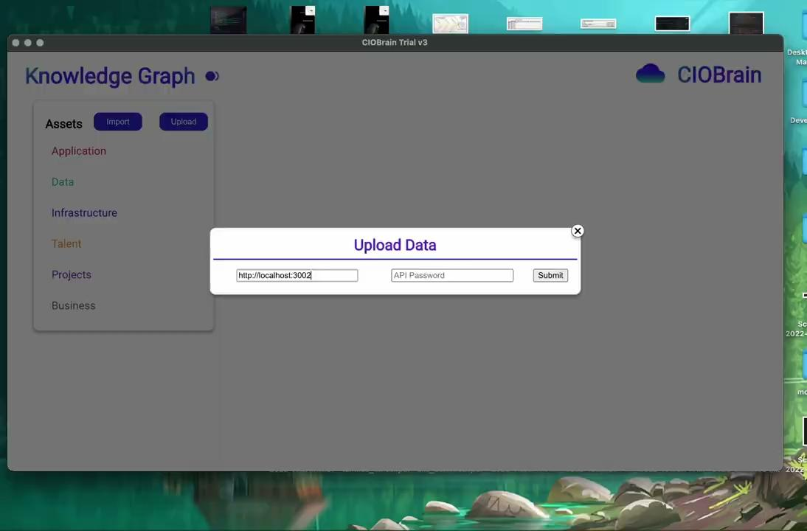
Data transfer Demo

Slide 20
06
Azure
Script
Easier cloud deployment

Slide 21
Running Azure Deployment
The Easy Way
Often times the CIO this product is intended for is not a technical stakeholder, but it is still important that they can deploy the application to a website.
This script requires no prior knowledge of Azure or web hosting to run.

Slide 22
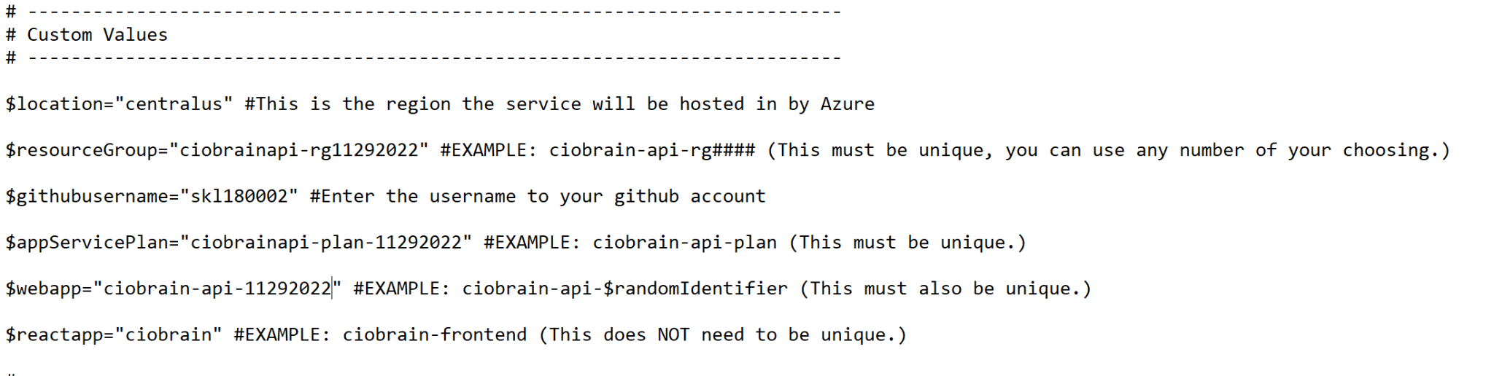
Running Azure Deployment
Certain values must be unique for deploying to Azure, in addition to the script requiring the user’s github username. These are stored in a text block.
SET UP

Slide 23
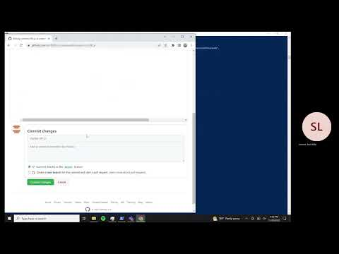
Running Azure Deployment
Running the Script

Slide 24
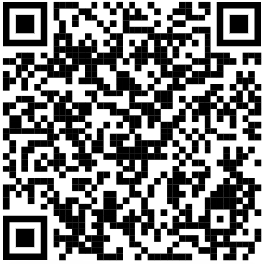
Try the deployed CIOBrain application on your phone!

Slide 25
THANKS!
Special thanks to Dr. Hill for his support and guidance throughout the project

